Slide 1
SKKU Parking Guide
Real-Time Parking App
Weekly Progress
Team I-dle Kim Seheon Kim Hyeongjin Noh Hayeon Park Inchan

Slide 2
Contents
Project Overview
Weekly Progress
Front-Back Integration / Model Improvement / Challenges
Future Plan
Next steps for project advancement
Team Contributions

Slide 3
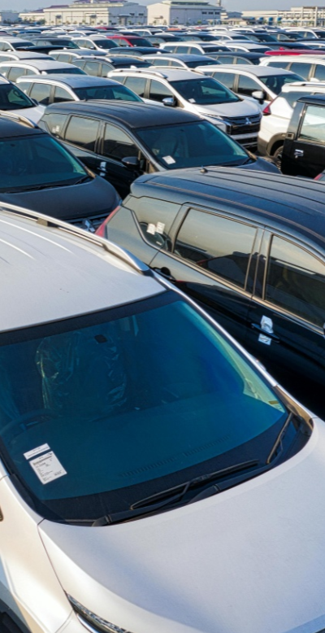
Project Overview
#1
Parking management system uses
to detect car park vacancies
Technical Background
1. YOLOv5:
real-time analysis of parking spaces and vehicle sizes.
2. Camera and AI integration system:
Data collected by cameras is processed by AI model, stored in a database, and linked to a mobile app.

Slide 4
Weekly Progress
#2
~Week9 | Week10 | Week11~
System Integration
Model improvement
Protection box

Slide 5
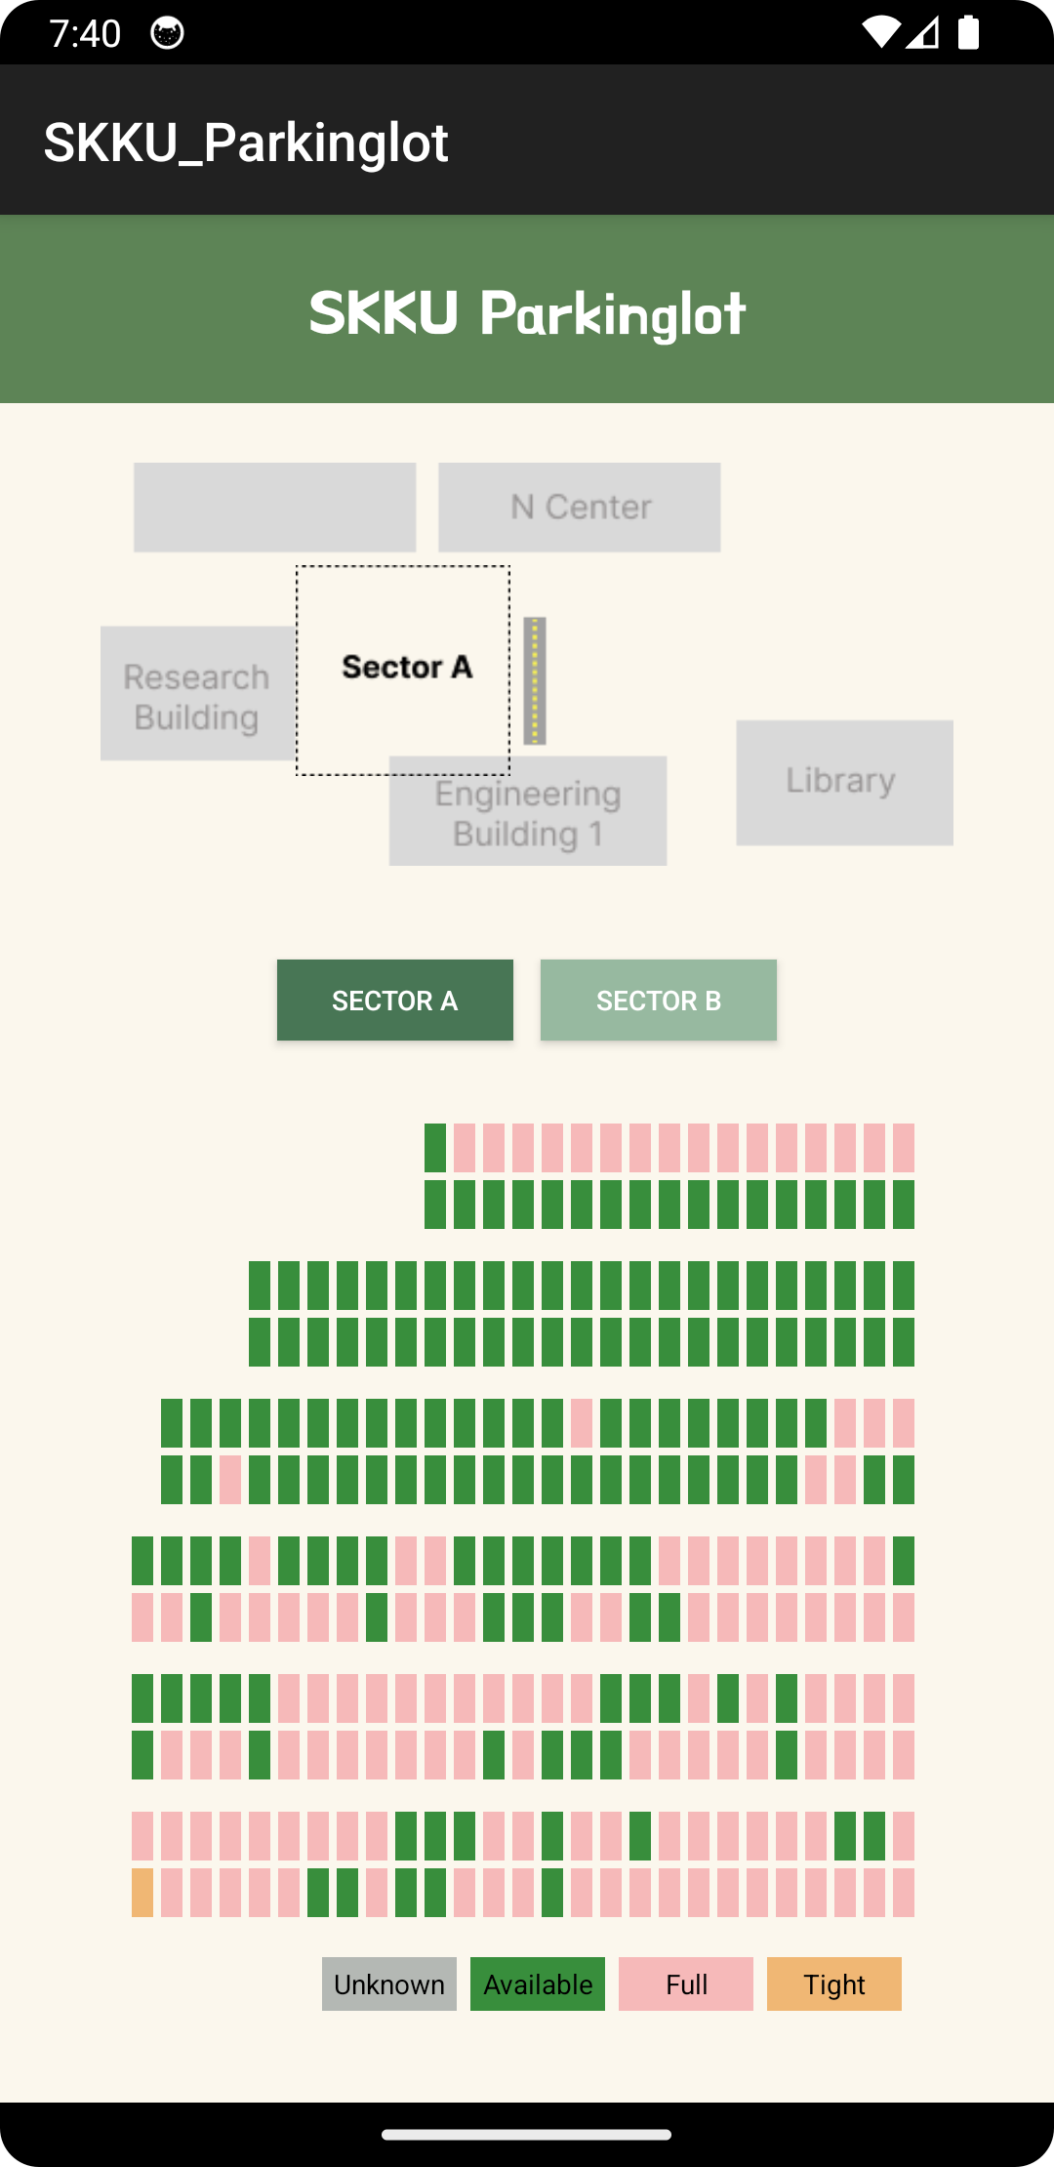
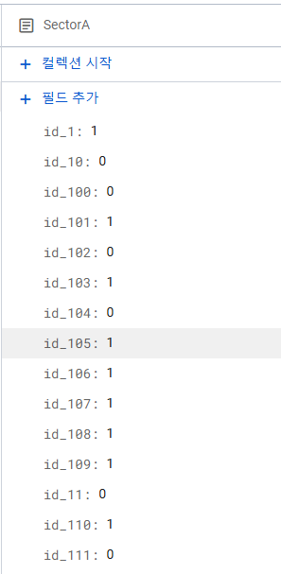
Front-Back Integration
#2.1
Completed the basic configuration of the app based on the design.
Designed an intuitive UI to provide users with real-time parking space information.

Slide 6
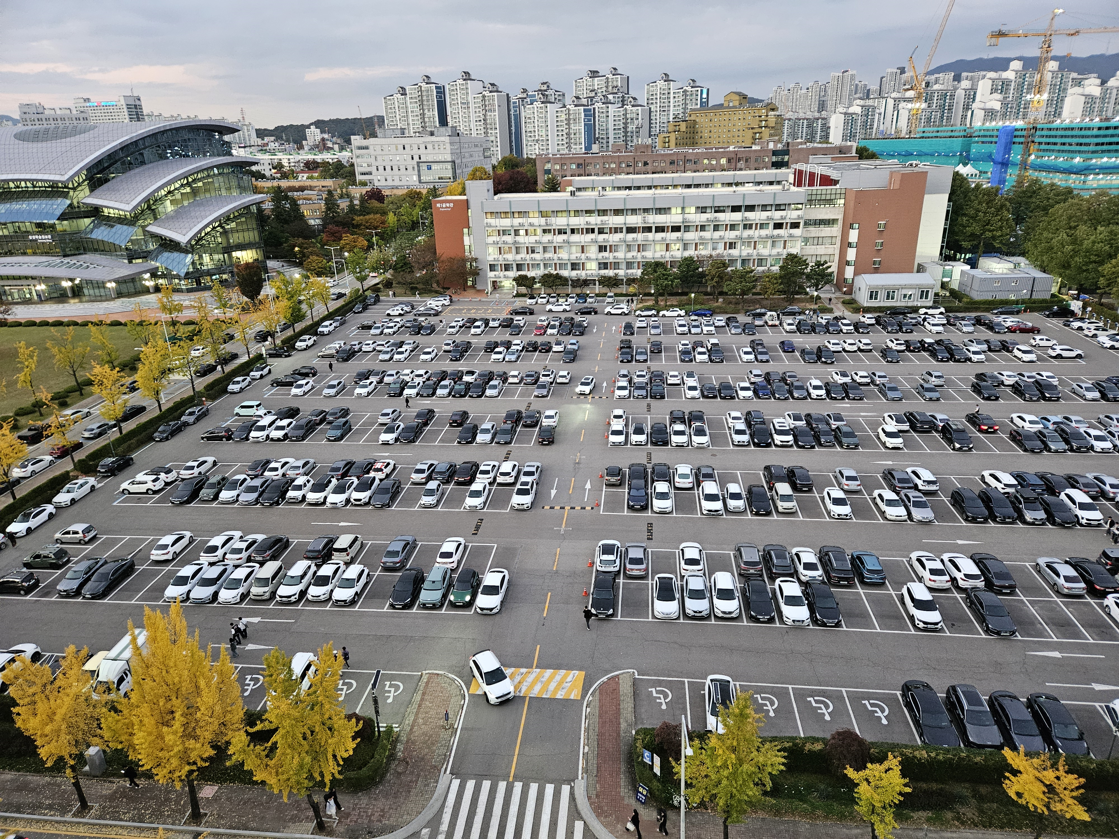
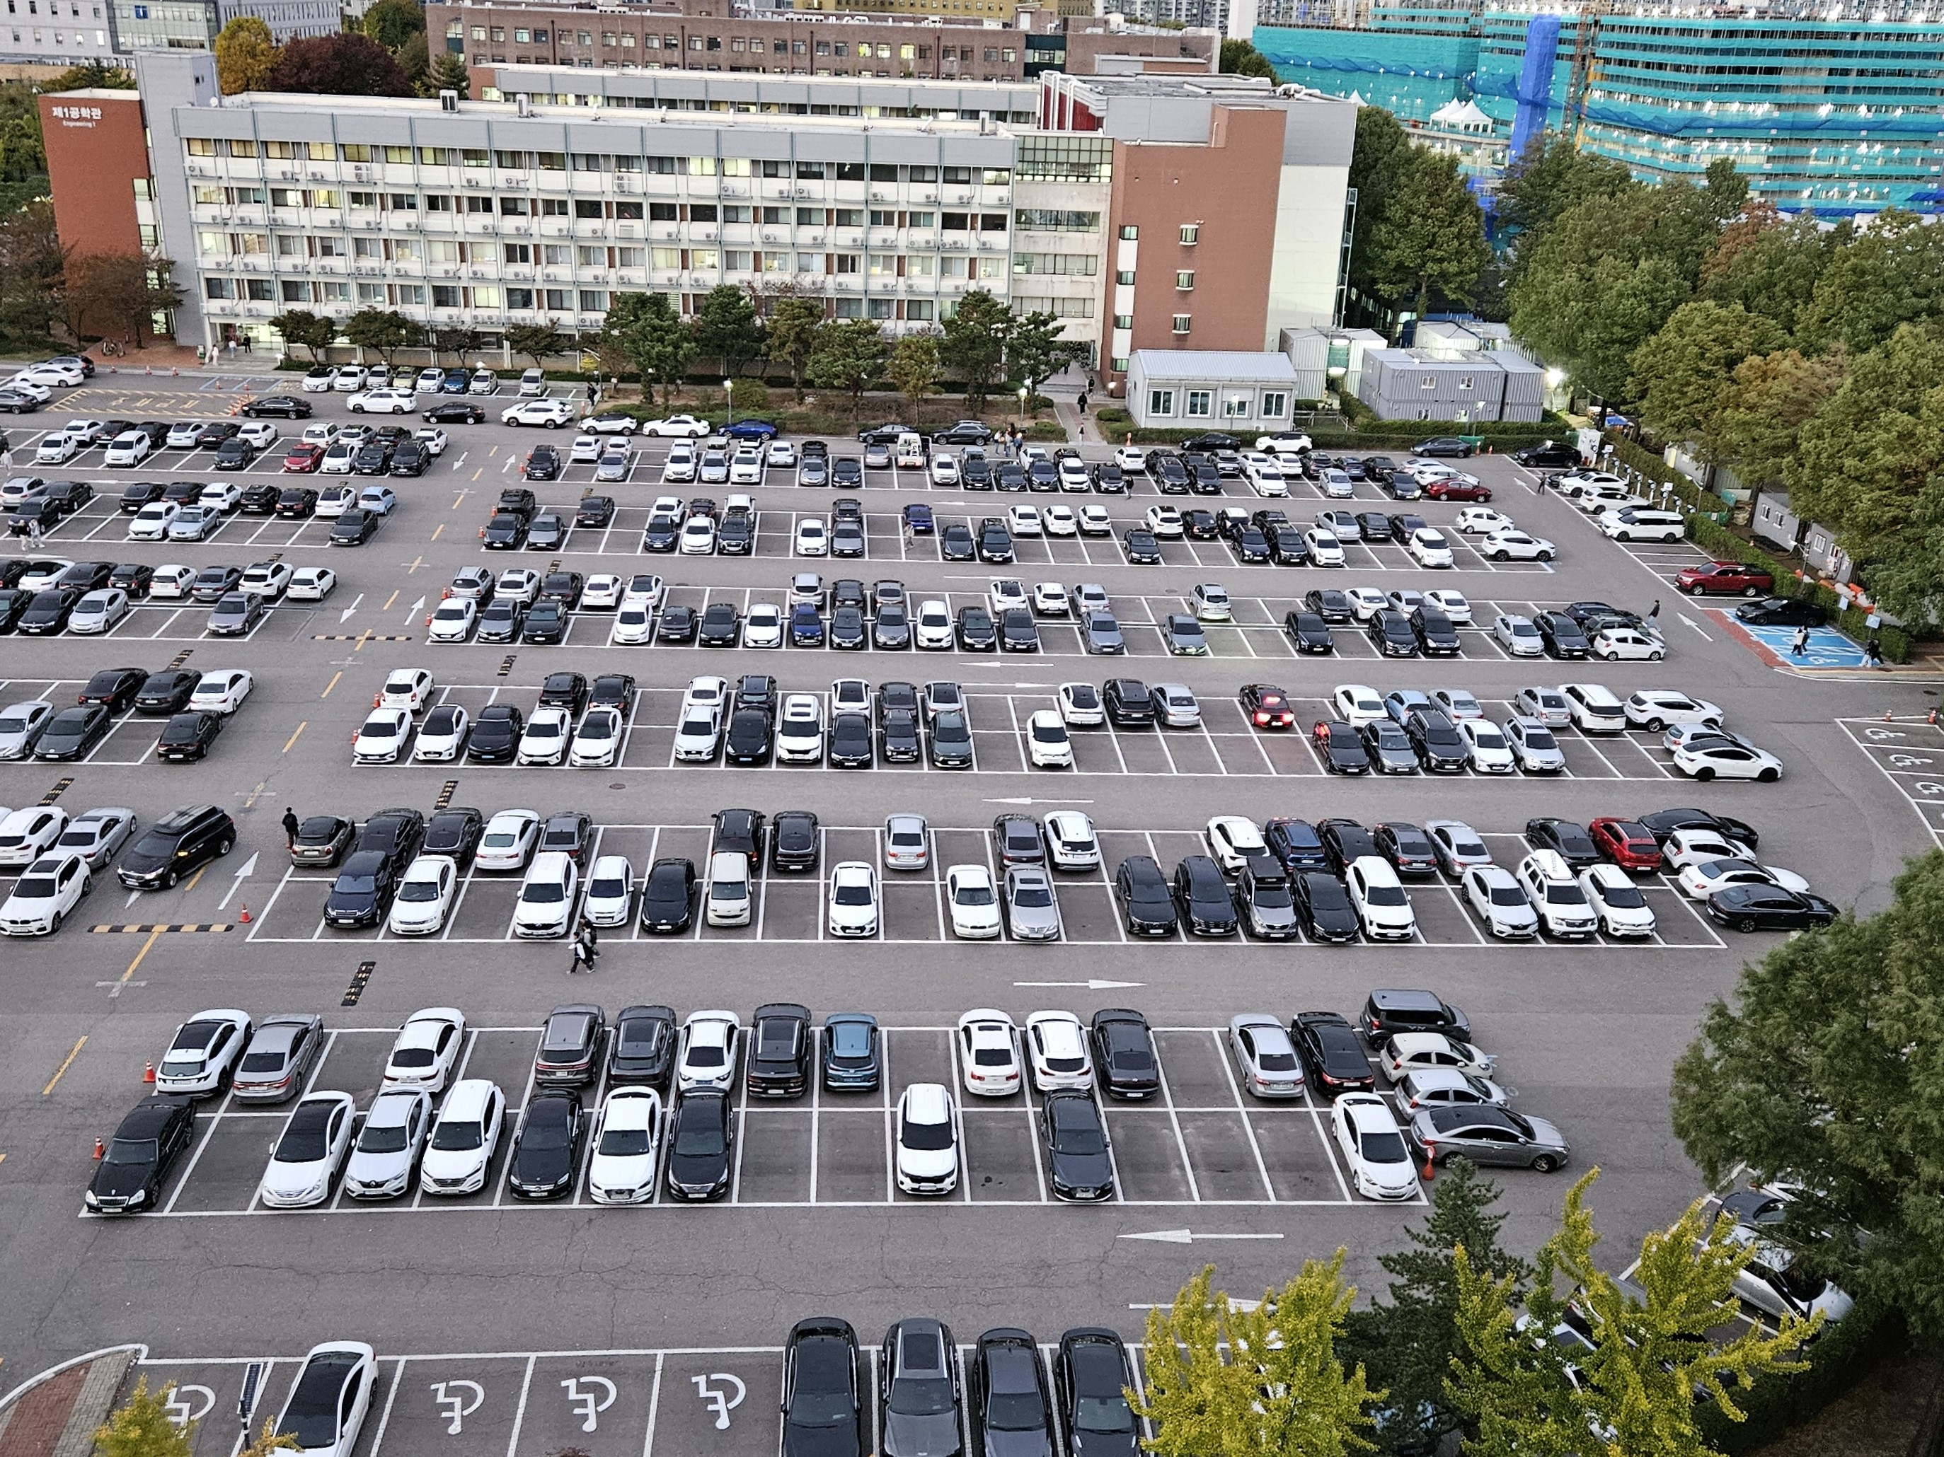
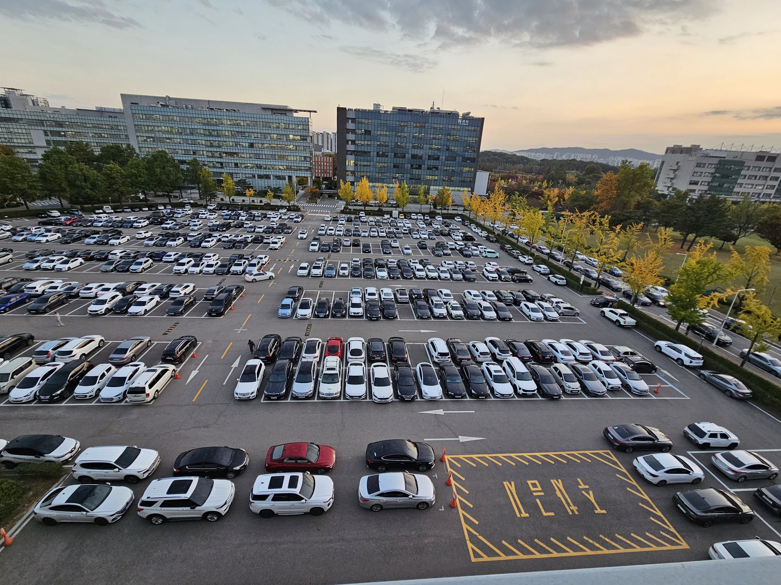
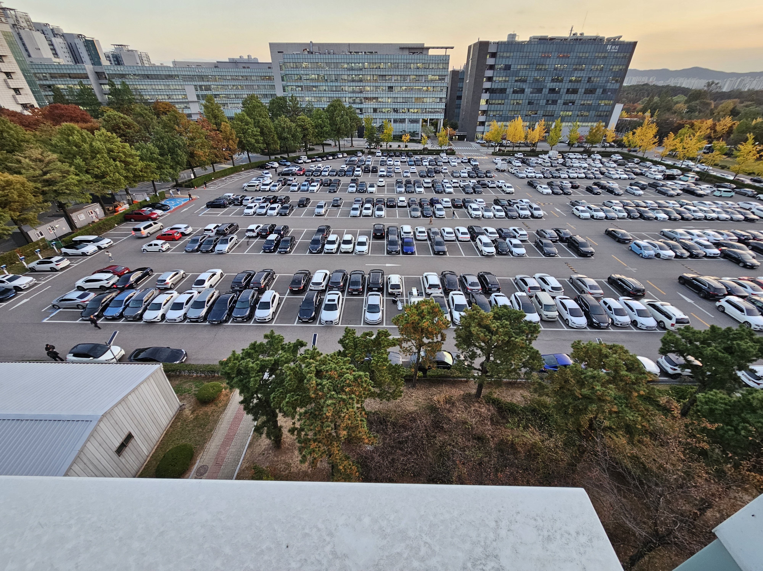
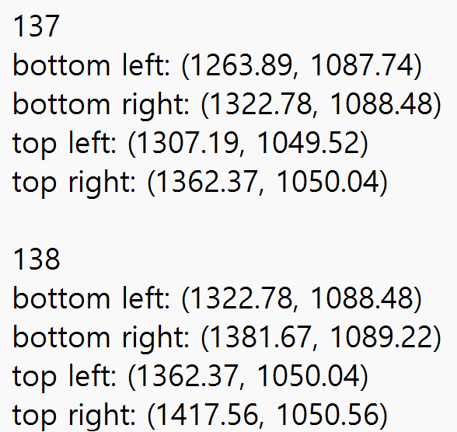
Model Improvement
#2.2
Pharmeceutical
View A
Pharmeceutical
View B
Engineering
View A
Engineering
View B

Slide 7
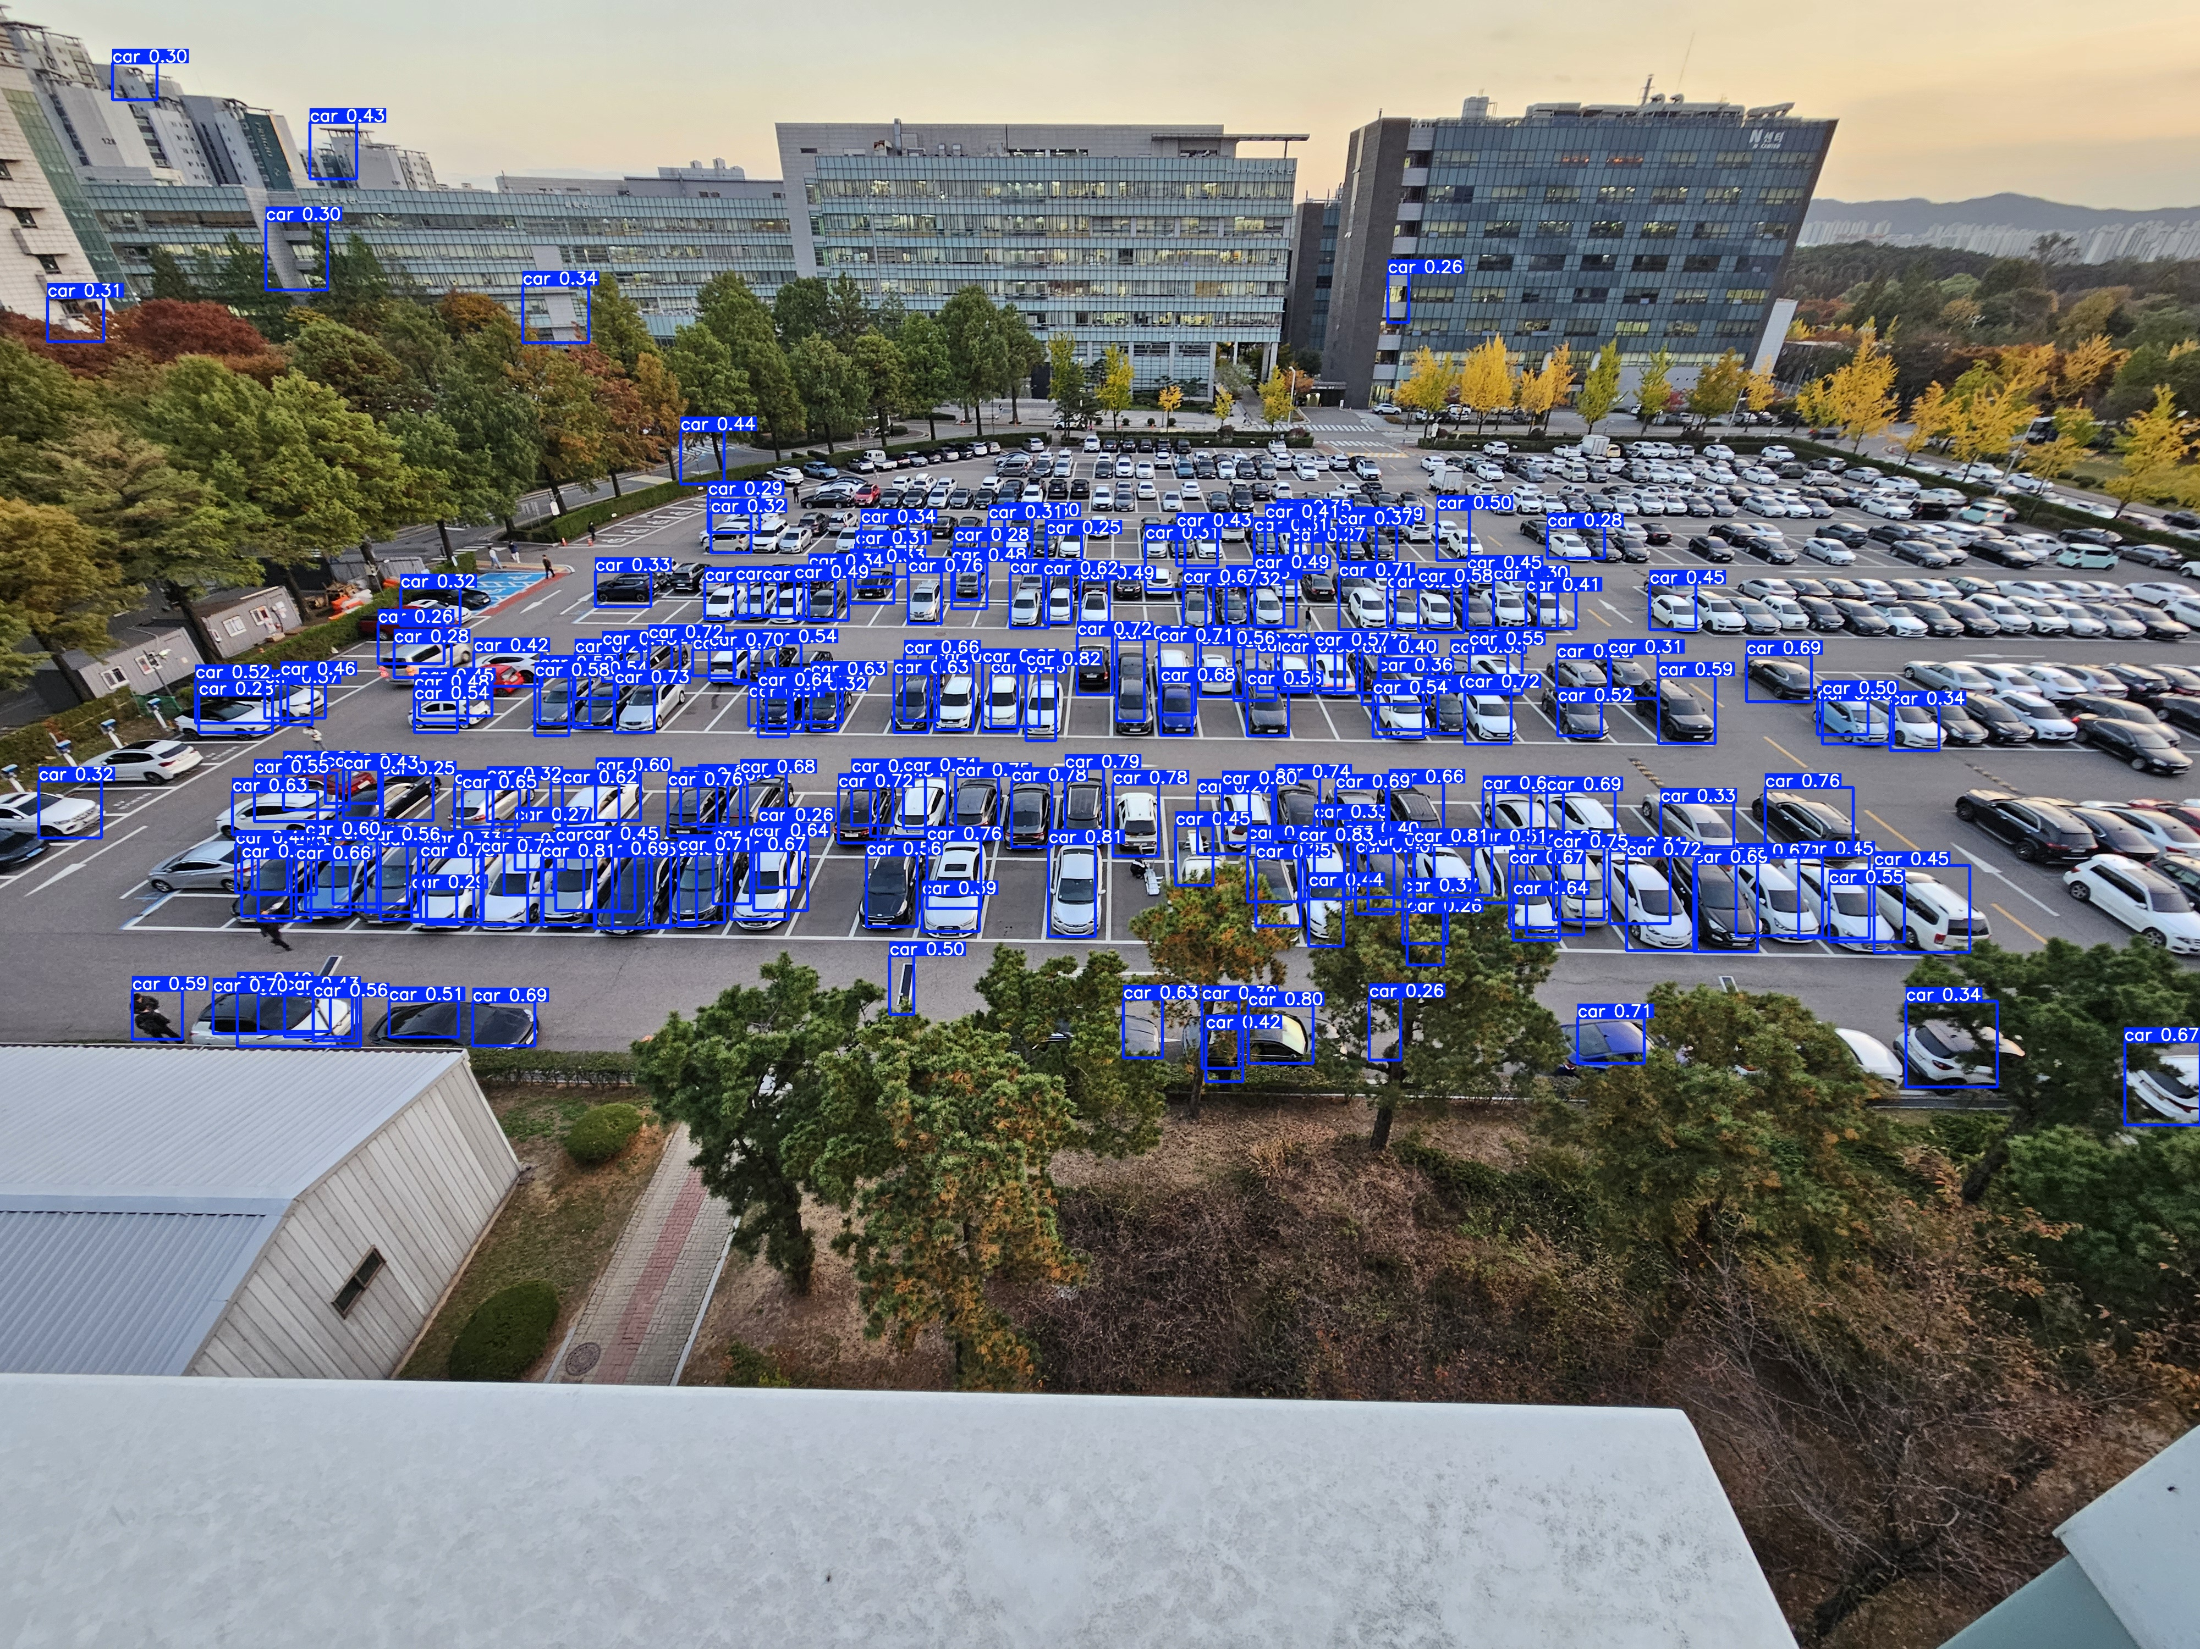
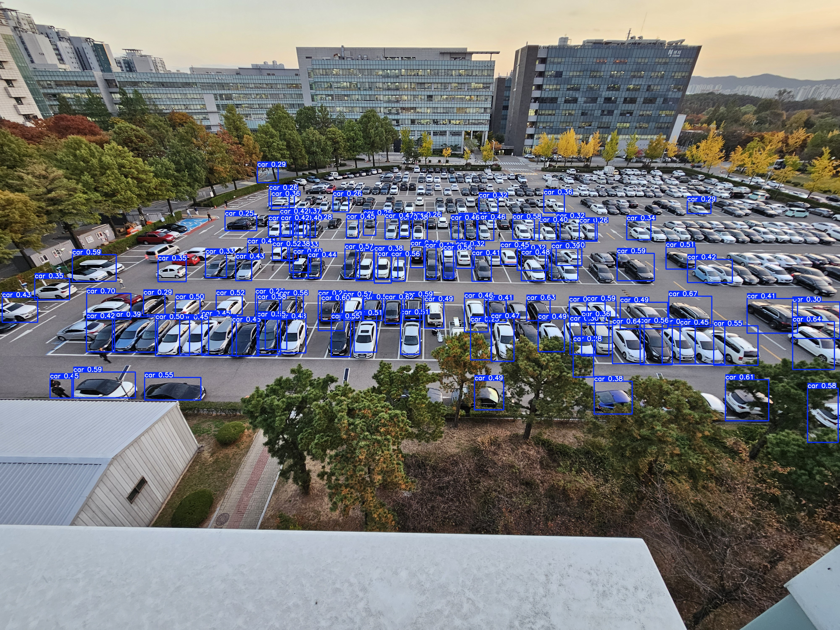
Model Improvement
#2.2-1
(training dataset)
YOLO
(detect result)
(but accuracy get worse..)

Slide 8
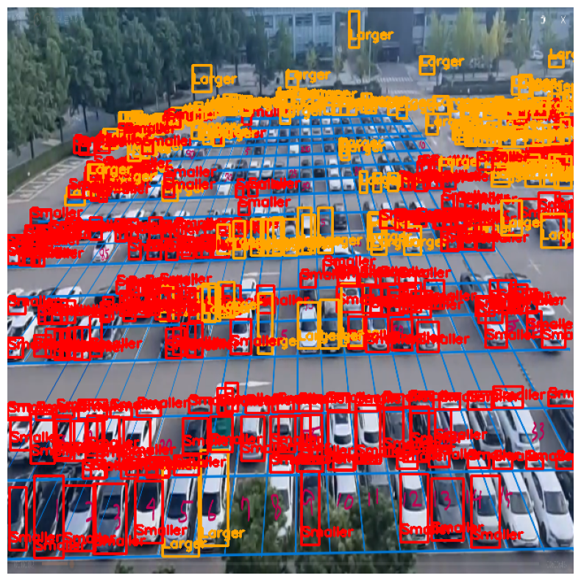
The tightness of the space
#2.3
The image is tilted, so it is not worked.

Slide 9
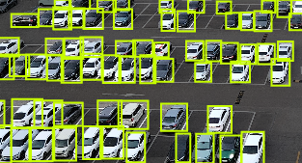
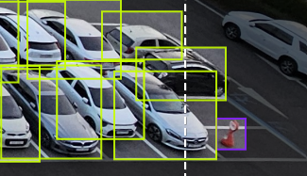
Dataset Customization
#2.4
Data Labelling for each compartment

Slide 10
Future Plan
#3
Model improvment
Testing
With Custom dataset training
01.
02.
03.
04.
Protection Box
Model Evaluation
- For protecting camera system

Slide 11
Team Contributions
Kim Seheon
Kim Hyeongjin
Noh Hayeon
#4
Park Inchan
Team Leader
Front-end
Development
Data Labelling
System Integration
Data Labelling
Testing AI model
Data Labelling
Model refinement
Data Labelling

Slide 12
Thank You

